Slide 1

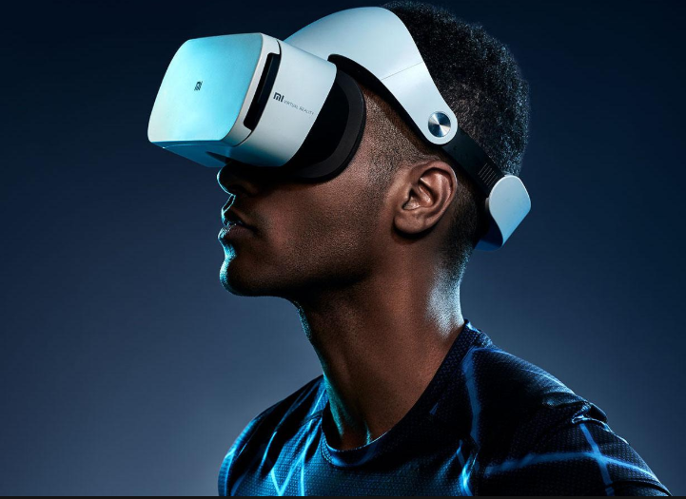
MUSEUM CORVUS
Digital Storytelling on a Virtual Heritage Museum with Believable Agents based on Turkish Horror Folklore
Team Members:
Oğulcan Merdivanlı
Hasan Saygın Dikbayır
Utku Mert Degirmenci
Advisor: Murat YILMAZ, Doç. Dr. Instructor
Co-advisor: Ulaş GÜLEÇ, Dr. Lecturer

Slide 2
Objectives of the Study
Definition: Developing a virtual environment to bring back long-forgotten Turkish horror culture.
Designed for every individual who are interested in horror or Turkish folklore.
Compatible for both PC and VR medium.
Main Features
Presenting a museum experience based on Turkish horror culture.
Digital storytelling
Realism with believable agent concept
Constraints
Lack of written sources leads to uncertainty about the folklore.

Slide 3
Basic Objectives
Purpose of our Project
Problem
Solution
Cultural heritage that have been forgotten
Hard to gather information through other sources.
Deficiency of storytelling on current sources
Difference of horror factor person to person.
Revive the Turkish horror culture with the museum concept.
Providing accurate and easy to understand information about the culture.
Professional scenario with the help of Gerisi Hikaye Team.
Personal characteristics based story generation.

Slide 4
Pros and Cons to Similar Projects
Projects | Sophisticated AI | Storytelling | Cultural Heritage | Narration | Interaction | Based on Real Museum
3d Murale | ✘ | ✘ | ✔ | ✘ | ✔ | ✘
ARCO | ✘ | ✘ | ✔ | ✘ | ✔ | ✔
Virtual Dig | ✘ | ✘ | ✔ | ✘ | ✔ | ✔
Woofbert | ✘ | ✔ | ✔ | ✔ | ✔ | ✔
Museum Corvus | ✔ | ✔ | ✔ | ✔ | ✔ | ✘

Slide 5
Success Criterion
Success Criterion | How to Measure
Immersive storytelling environment | Interview with the playtesters
Feasibility of the overall features | Traceability Matrix
Accurate representation of the creatures | Interview with the Gerisi Hikaye team
Efficieny level of didactic quality | Interview with the playtesters and Gerisi Hikaye team

Slide 6
Potential Risks
Risks | Potential Impact | Plan B | Importance
Failure of the game mechanism | Inacceptable output | Implementing a feedback functionality to make imrovements | High
Lack of realism | Reduction of immersion | Correcting defects by releasing patches | Medium
Problems about the cultural environment | Incorrect representation of the Turkish motives | Gathering unique assets | Low
Trouble with the story flow | Boredom and loss of relevancy | Meetings with the Gerisi Hikaye team to fix the flow | Medium

Slide 7
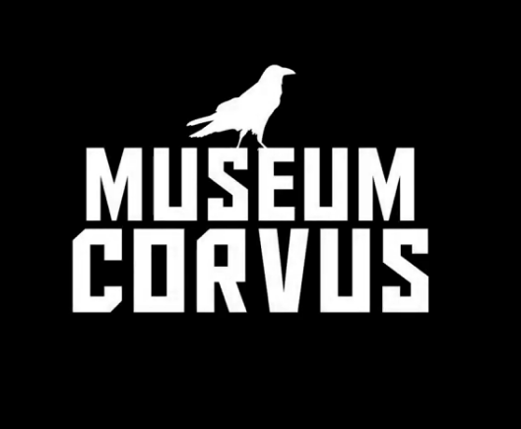
Museum Corvus
Here we explain working principle of our project
Virtual Reality Desktop Application (Windows 10)
The scope of this project is the treatment of the cultural elements belonging to horror stories of Turkish culture with a virtual museum concept.
Oculus DK2 compatible
Single simulation mode.

Slide 8
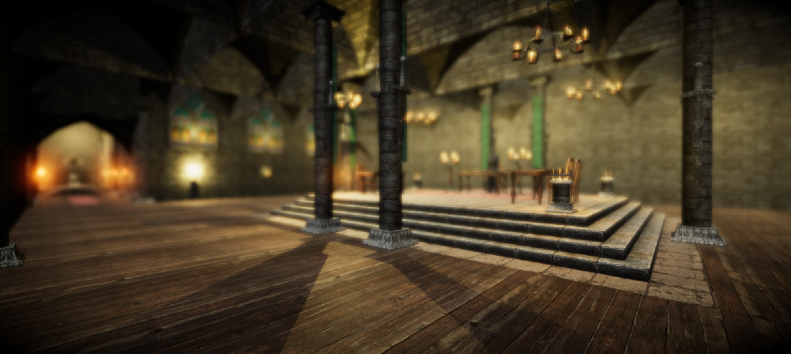
Museum Corvus
Here we explain working principle of our project
Story Mode
Story mode is designed to give the user a storytelling experience that he/she has never experienced before.
This mode will consist of 2 phases:
Survey Phase
Play Phase

Slide 9
Museum Corvus
Here we explain working principle of our project
Stated systems involve with following terms:
Event System: Designed to push the player to experience the story.
Survey System: Designed to give the an experience that fits player’s fear.
Navigation System: A* Search Algorithm for path finding and chasing.

Slide 10
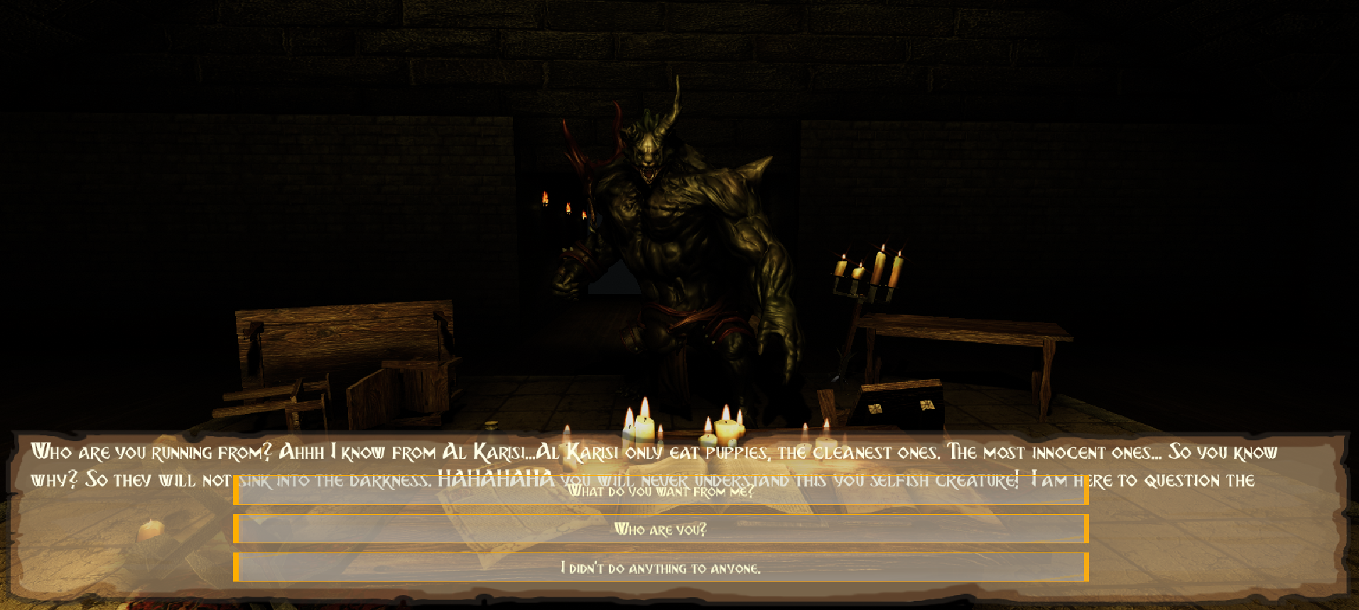
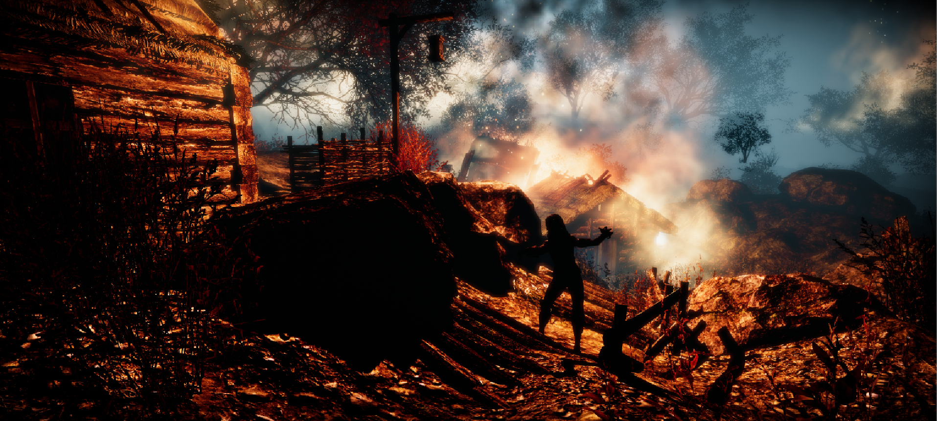
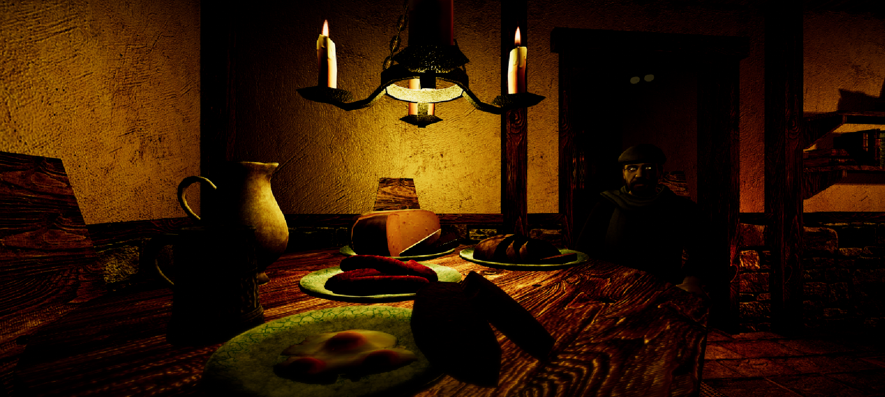
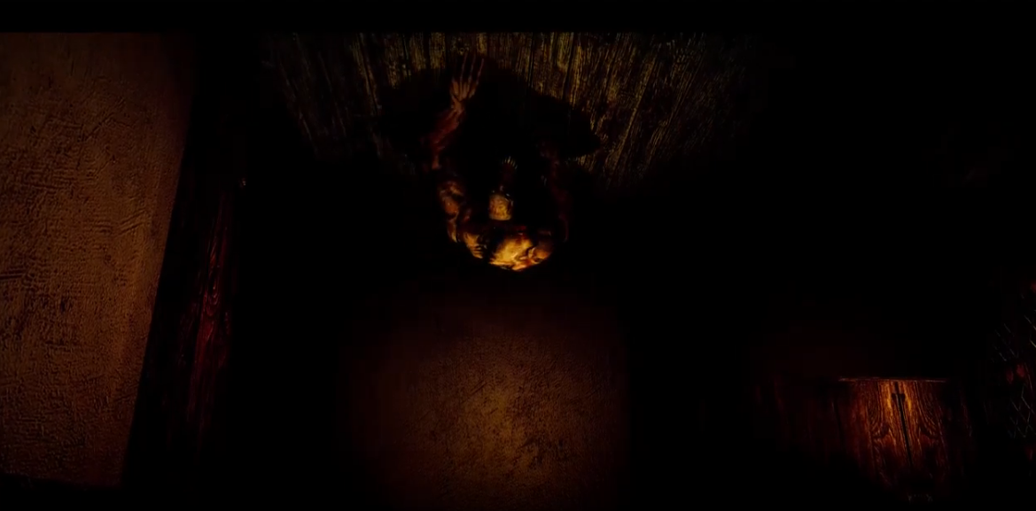
Outputs of the Project

Slide 11
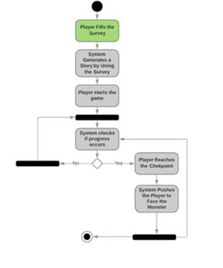
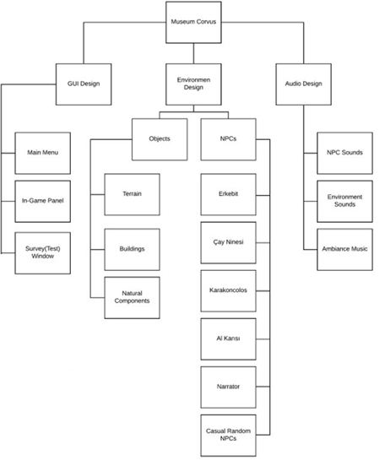
Materials and Methods

Slide 12
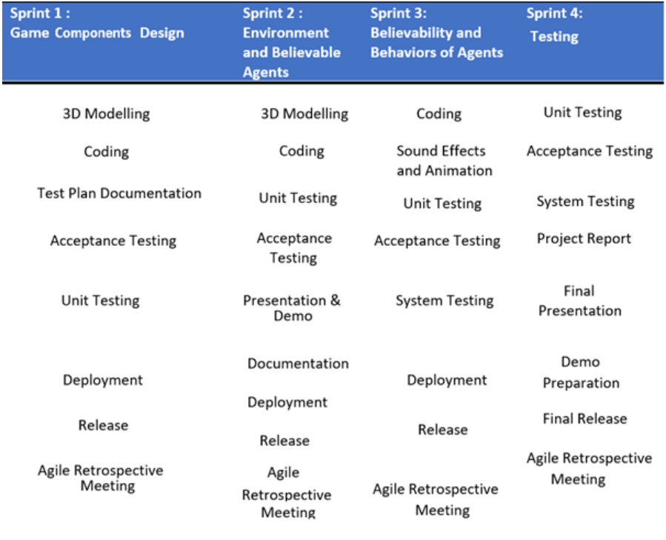
Development Methodology
Development Methodology
Throughout the project, two different methodologies used.
Tentative Project plan for CENG407, the phase of documentation.
Scrum for CENG408, the phase of implementation

Slide 13
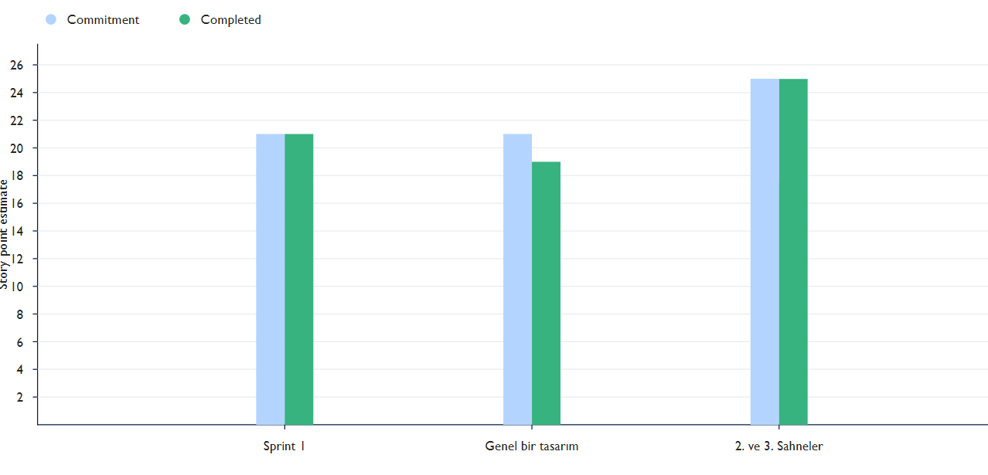
Development Methodology

Slide 14








Technology Used
Unity 3D Game Engine
Zbrush
Autodesk Maya
Photoshop CC 2018
Illustrator CC 2015
Mixamo Fuse
Visual Studio Community 2017
Ableton Live 9

Slide 15

Tübitak Application
Earned Tübitak Program
2209-B Sanayiye Yönelik Lisans Araştırma Projelerini Destekleme Programı 2018/6

Slide 16
Acknowledgement
We are grateful to:
Assoc. Dr. Instructor Murat YILMAZ,
Dr. Lecturer Ulaş GÜLEÇ,
Bora GÜNGÖREN,
Gerisi Hikaye Team
Sinan AYYORGUN
Thank you for your guidance and your passion throughout the Project.

Slide 17


ANY QUESTIONS?

Slide 18
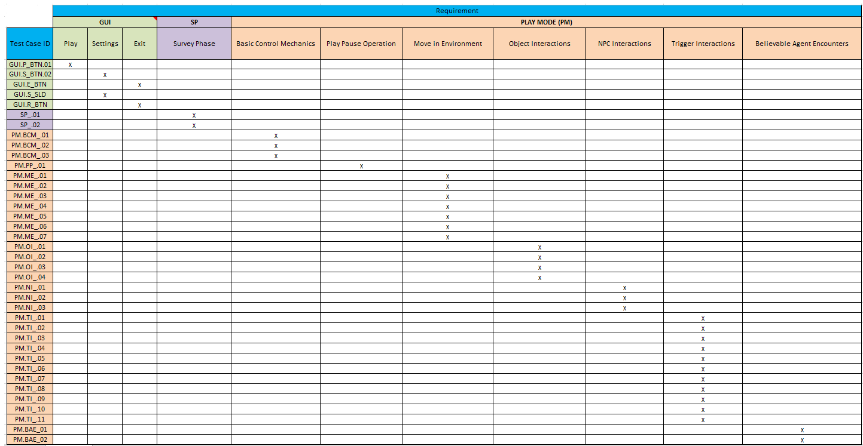
Traceability Matrix

Slide 19
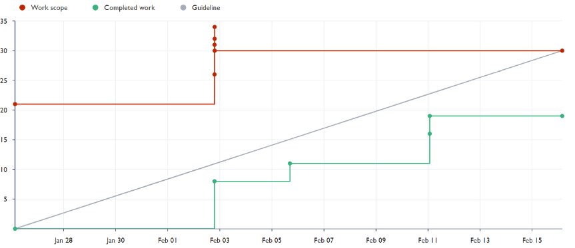
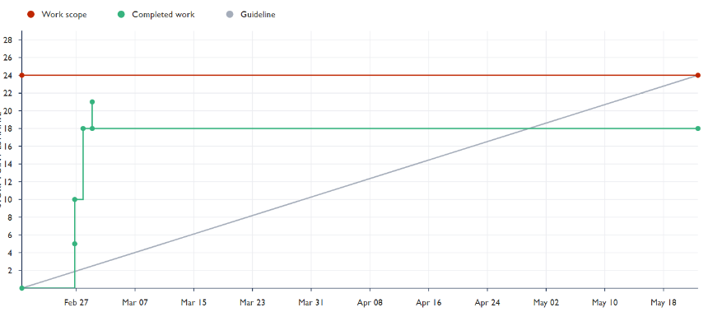
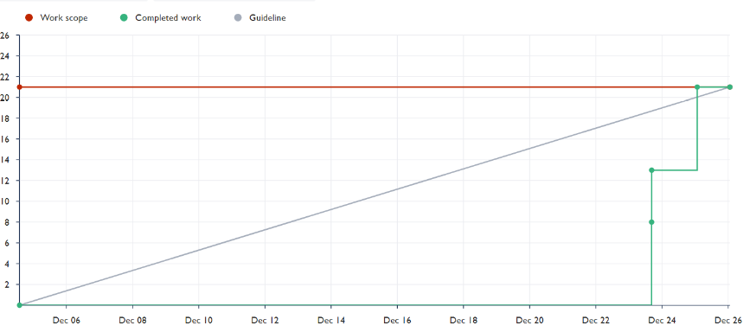
Spirint 2
Spirint Reports on Jira
Spirint 1
Spirint 3

Slide 20
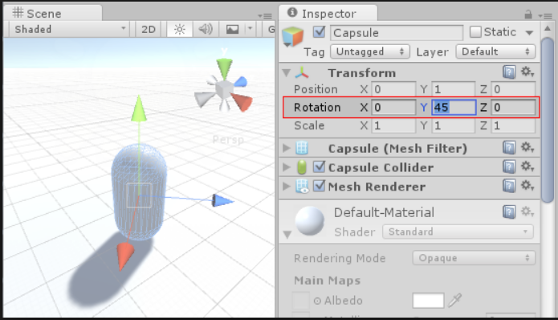
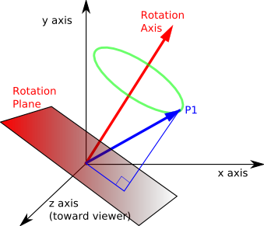
Quaternion
Quaternions are used to represent rotations.
They are compact, don't suffer from gimbal lock and can easily be interpolated. Unity internally uses Quaternions to represent all rotations.

